Slide 1
Best Practices for Developing 2026 Annual Meeting Submissions
February 24, 2026
Co-sponsored by the ACLP Mentorship Subcommittee, Annual Meeting Committee, and Subcommittee on Accessibility, Fellowship, & Engagement (SAFE)

Slide 2
Presenters
Samuel Greenstein, MD, FACLP | Larkin Kao, MD, FACLP | Molly Cinderella, MD | Damien Miran, MD
Webinar Chair, Mentorship Subcommittee | Program Chair, CLP 2026 | Chair, General Sessions Subcommittee | Vice Chair, General Sessions Subcommittee
Kelly Cozza, MD, FACLP | VaKara Meyer Karre, MD | Deepika Sundararaj, MD
Chair, Preconference Courses Subcommittee | Chair, Brief Oral Papers and Posters Subcommittee | Vice Chair, Subcommittee on Accessibility, Fellowship and Engagement (SAFE)

Slide 3
CLP 2026: Outline
Theme
Timeline
Highlights and clarifications
Encouragement

Slide 4
Expanding the Vision of C-L Psychiatry:
New Roles, New Settings, New Pathways

Slide 5
Expanding the Vision of C-L Psychiatry:
New Roles, New Settings, New Pathways
For what roles in the healthcare system are C-L psychiatrists uniquely suited to contribute, beyond direct patient care or traditional consultation models?
What settings could benefit from more or different types of C-L presence?
How is our field developing new pathways in research, clinical care, and education to better serve our patients and to strengthen our subspecialty?

Slide 6



Expanding the Vision of C-L Psychiatry:
New Roles, New Settings, New Pathways
Unique roles for C-L psychiatrists in wellness, career development, and advocacy | New or evolving models of C-L care delivery | Ways to practice C-L in rural, nonacademic, or other “non-traditional” settings | How to integrate technology into C-L practice
The role of C-L psychiatry in integrating inpatient and outpatient care | Innovative models in C-L training | Global models of C-L care and education

Slide 7
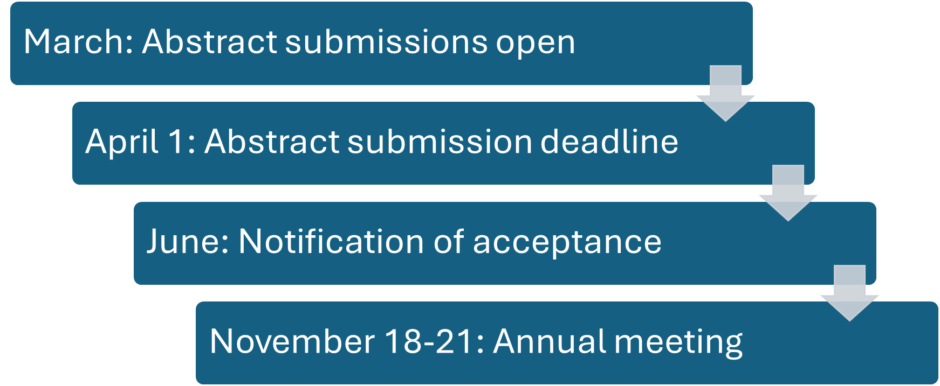
Timeline for Submissions

Slide 8




Highlights and Clarifications
Wednesday meeting start
In-person and virtual options
SIGs and subcommittees
CME eligibility

Slide 9
Encouragement
Annual meeting submissions are competitive!
If your submission is not accepted this year, do not despair
Common experience
Many ways to participate in ACLP, and the Annual Meeting, beyond abstract presentation
Session Type | % Accepted to CLP 2025
General Sessions | 53
Posters | 58
Oral Papers | 56
Preconference Courses | 44

Slide 10
Abstract Pre-Review Pilot
Pilot program this year from Research Subcommittee and Annual Meeting Committee
Due 3/1
For ACLP members who are:
Trainees or ECPs
Do not have ready access to mentorship in their network
Have not had any past ACLP submissions accepted
Provides editing but no guarantee of acceptance

Slide 11
Integrating Breadth and Depth into Submissions Subcommittee on Accessibility, Fellowship and Engagement (SAFE)

Slide 12
Integrating Depth and Breadth Into the Program
ACLP remains committed to creating a welcoming and respectful community that reflects a broad range of perspectives and experiences, and encourages authors to do both of the following:‎
1. Provide balanced information regarding presentation, including, but not limited to, how the topic affects communities with less representation in research or individuals from marginalized groups, as well as gaps in research, access, or outcomes.
‎2. Include speaker panels that reflect the breadth of our diverse Academy membership, with participation from speakers of differing identities, professional backgrounds, geographies, institutions, and career stages.‎
Notes:
All submissions require a response to the question (100-word limit):
How or why will your submission advance the breadth and depth of the ACLP 2026 meeting through topics presented and/or speaker panel?

Slide 13
Contributions to Breadth and Depth Can Take Many Forms

Slide 14
Enhancing Breadth and Depth: Topics Presented
Document and critique health and healthcare disparities within the clinical topic(s) presented
Discuss ways to promote health equity, reduce health and healthcare disparities, and improve the health of marginalized populations, within the clinical topic(s) presented
If no research/evidence exists on health and healthcare disparities on the clinical topic(s) presented, discuss why and suggest targets for future study
Present examples of public service for diverse populations, e.g.,: educational presentations, outreach, partnerships with community-based organizations with the goal of improving health and wellness in communities
Incorporate health and healthcare disparities, health equity, structural competency into core educational content
Notes:
Example 1: delayed recognition of signs and symptoms within those that are understudied as far as their specific (culture-influenced,..) manifestations of illnesses,..
Example 2: psychopharmacological studies to include diverse patient populations so that there is less of limited data on drug efficacy and SE of non-White patients.
Example 3: interpreter services and culturally tailored mental health screening tools in CL psychiatry services
Example 5: CSF analysis in the evaluation of psychiatric symptoms: advancing precision medicine or overmedicalizing mental illness?

Slide 15
Enhancing Breadth and Depth: Topics Presented
Develop or use pedagogies that address different learning styles and/or learning disabilities
Advance equitable access to education and outreach for marginalized groups
Develop and utilize resources and tools that encourage the recruitment and retention of diverse learners, faculty and staff
Assist attendees from marginalized groups towards academic and professional advancement within their institutions and ACLP
Notes:
1- historically marginalized
Example 1: delayed recognition of signs and symptoms within those that are understudied as far as their specific (culture-influenced,..) manifestations of illnesses,..
Example 2: psychopharmacological studies to include diverse patient populations so that there is less of limited data on drug efficacy and SE of non-White patients.
Example 3: interpreter services and culturally tailored mental health screening tools in CL psychiatry services
Example 4: panel discussion that includes those from various disciplines including a patient advocate, a CL psychiatrist, social worker discussing disparities in psychiatric care for homeless patients in hospital setting.
Example 5: CSF analysis in the evaluation of psychiatric symptoms: advancing precision medicine or overmedicalizing mental illness?
Example 6: Digital biomarkers in CL psychiatry: the future of digital mental health tools.

Slide 16
Enhancing Breadth and Depth: Speaker Panel
Include speakers of diverse identity, including but not limited to: age, race, ethnicity, gender identity, sexual orientation, immigration status, disability
Incorporate speakers from different professional backgrounds: non-psychiatrist physicians, advance practice practitioners, social workers, nurses, PT/OT, basic scientists, engineers, etc.
Include speakers from varying career stages: trainee, early career, mid-career, late career
Mentor and sponsor speakers from early career stages, historically marginalized groups
Include speakers that represent a diversity of institutions
Notes:
Example 4: panel discussion that includes those from various disciplines including a patient advocate, a CL psychiatrist, social worker discussing disparities in psychiatric care for homeless patients in hospital setting.

Slide 17
Statement Examples
“This case highlights diagnostic overshadowing in a medically ill patient from an underserved background, examining how bias can delay recognition of serious medical conditions in individuals with severe mental illness. We use this case to discuss equity-informed consultation practices and strategies to improve diagnostic accuracy in marginalized populations.”
“Our presenter group spans varied training levels, disciplines, and lived experiences. These perspectives shape how we conceptualize patient care, systems barriers, and stigma in medical psychiatry. By modeling collaborative dialogue across differences, the session broadens how attendees approach equity and team-based consultation work.”
“This submission showcases the expanding interface between consultation-liaison psychiatry and other medical specialties. Through interdisciplinary case work, we demonstrate how psychiatric input enhances care in complex neurologic, cardiac, and infectious disease presentations while promoting holistic, patient-centered outcomes.”

Slide 18
Statement Examples
“We explore how advances in psychoneuroimmunology and gut–brain research are reshaping psychiatric formulation in medical settings. The session translates evolving science into practical consultation frameworks, emphasizing how biologic discoveries intersect with psychosocial and structural determinants of health.”
“In addition to clinical content, this session highlights training and workforce implications, offering teaching tools that prepare clinicians to address disparities within hospital psychiatry. Faculty and trainee presenters model mentorship and career development across stages.”
“We examine systemic obstacles that limit equitable psychiatric care for medically complex patients, including insurance limitations, language access, and care fragmentation. The session proposes consultation models and institutional interventions that improve access and continuity of mental health treatment.”

Slide 19
Best Practices: General Sessions
Molly Cinderella MD, Chair
Damien Miran MD, Vice-Chair
Clinical Director, DFCI Inpatient Psychiatry Consult Service
Department of Supportive Oncology

Slide 20
Major takeaways for General Sessions Committee in 2026
Categories & Tag System (Dr. Miran)
Will still specify in-person or virtual
AMEDCO review process
Limited feedback for declined submissions for General Sessions only*
Unchanged: 75 minute length, 4 speakers, review process
Notes:
Categories & tag system will allow us to compare apples to apples more accurately Will also be searchable for meeting attendees Dr. Miran did bulk of work putting htis together and will present it.
Still working out what feedback will look like, likely synthesis of comments.

Slide 21
AMEDCO review process
• The session or paper cannot be about the controversial agent/treatment, but can be about the condition the agent/treatment addresses.
• Additional treatments must also be included, in addition to those of a controversial nature.
• Faculty must acknowledge and identify the content as controversial in nature and explain why that is the case.
• Content must provide evidence/arguments showing both sides of the debate around the agent/treatment.
• The content must be impartial, and the faculty/content cannot take a position of advocacy.
• Any recommendations must be strictly limited to Federal Drug Administration (FDA)/American Medical Association (AMA)/American Psychiatric Association (APA) approved or endorsed uses only
Notes:
Categories & tag system will allow us to compare apples to apples more accurately Will also be searchable for meeting attendees Dr. Miran did bulk of work putting htis together and will present it.
Still working out what feedback will look like, likely synthesis of comments.

Slide 22
Major items the reviewers are considering when scoring abstracts
Abstract strength
Content appropriate for duration of 75 minutes and matched to preferred submission type (live vs virtual)
Ability to enrich participant engagement and interactivity
Especially considered for live presentations
Originality (not previously presented or published, unique topics and ideas) and diversity of topics

Slide 23
What are the features of a well written abstract proposal?
General Features
Well-organized
Clearly defines the content and timeline/plan for the presentation
Background
Content outline
Individual speaker topics (what value does the speaker bring; why is the speaker the right person, with the right role, and at the right time to discuss this?)
Timeline (who does what?)
Interactivity highlighted
Learning objectives
500-word limit (includes references!)

Slide 24
What type of abstracts are generally not accepted?
Proposals that:
Promote only one institution/program
Lack clear learning objectives
Session format does not match learning objectives
Contain insufficient content to fill 75 minutes (or overwhelming amount of content)
Lack originality, complete repeat of prior presentations
Single case reports or otherwise more appropriate for another format
Notes:
Moving from “workshop and symposia” language to general sessions intended to incorporate a wider variety of teaching styles. The goal is for presenters to be able to use the 75 minutes effectively for the topic and goals of their presentation.
For example, if the goals of the general session is largely to transfer knowledge (ie best practices for agitation in ICU), a traditional lecture format might be most appropriate
If the goal is for participants to leave with new skills (for example, how to advocate for a group of patients) a more interactive format would be more appropriate.

Slide 25
Examples of Well-Written Abstracts
Where Do We Go From Here? Understanding the Anti-DEI Movement and Igniting a DEI (R)Evolution Through CL Practice and Education - a DEI Subcommittee Sponsored Workshop
Highly topical/timely, discusses benefits (and misapplication) of DEI principles to medicine and medical education, discusses transformation from 20teens era DEI movement to virtue ethics, long period dedicated to discussion
Substance Use in Cancer Care: Innovative Psychiatric Approaches for Complex Needs
Did an excellent job outlining how CL psychiatrists are poised to care for a vulnerable population, laid out exactly what each presenter was responsible for, presented original data on trainee comfort level with buprenorphine in oncology population
A Tale of Two Ketamines: Clinical Innovation and Controversy at the Intersection of Mood and Substance Use Disorders
Laid out several interesting questions in first part of abstract (grabbed the reader), had a brief pharmacology review, covered a broad range of topics around ketamine use (misuse, depression, blurred boundaries in community), closed with cases and discussion. Unfortunately not CME eligible.
Notes:
Moving from “workshop and symposia” language to general sessions intended to incorporate a wider variety of teaching styles. The goal is for presenters to be able to use the 75 minutes effectively for the topic and goals of their presentation.
For example, if the goals of the general session is largely to transfer knowledge (ie best practices for agitation in ICU), a traditional lecture format might be most appropriate
If the goal is for participants to leave with new skills (for example, how to advocate for a group of patients) a more interactive format would be more appropriate.

Slide 26
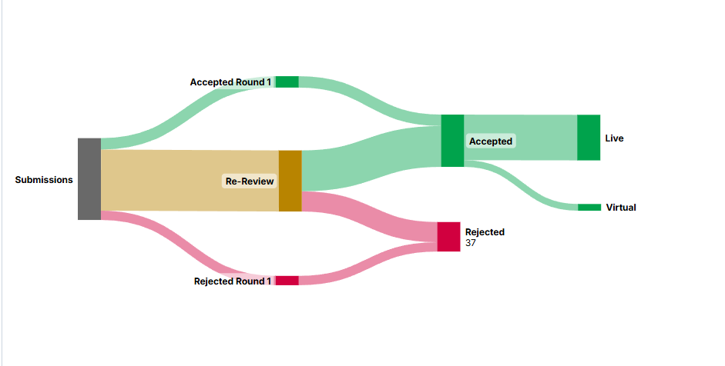
Sample Review Process
Round 1:Volunteer reviewers (thank you!); 1-10 overall score
Round 2: General Sessions Committee, 1-10 score and 4 separate subscales; consider score AND role of session in scientific program
Notes:
Note: This is pretty over-simplified. Last year we had several move from “accepted” to re-review to rejected due to issues with accreditation status. The main points are: Round 1 is just raw score. We have a pretty firm cutoff for “accepted”; for “rejected” we take some lower scoring abstracts with a higher Z score (ie if everyone gives you a 5 you will be rejected, if you get two 10s and two 1s you’ll be reviewed again)
The vast majority of submissions and practically 100% of submissions that make it to round 2 are good enough to go in the program Round 2 is a combination of the 10 point score, the supplemental questions designed to target depth/breath, innovation, relevance, and a general sense of “what does the program need”? FOR EXAMPLE: we might cut the lowest-scoring ethics presentation to ensure that there is some material dedicated to transplant, or decide between two very similar delirium presentations - this varies a lot year to year and is pretty subjective. A general sense is probably 2/3 of round 2 is score, and 1/3 is rounding out the program.

Slide 27
Supplemental Questions (second round only!)
On a scale of 1-4 (1 = minimally, 4 = extremely) Does this submission meaningfully incorporate the meeting theme or address a high-priority topic?
On a scale of 1-4 (1 = minimally, 4 = extremely), how relevant is this submission for practice of C-L psychiatry in inpatient and outpatient settings?
On a scale of 1-4 (1 = minimally, 4 = extremely), how novel is the topic of this submission?
On a scale of 1-4 (1 = minimally, 4 = extremely), how much will this submission meaningfully enhance the depth and breadth of the CLP 20265 scientific program?
For reference, submitters were asked to comment on how or why their submissions would advance the breadth and depth of the ACLP 2026 meeting through topics presented and/or speaker panel, with an explanation as follows: “ACLP remains committed to creating a welcoming and respectful community that reflects a broad range of perspectives and experiences, and encourages authors to do both of the following:‎
1. Provide balanced information regarding presentation, including, but not limited to, how the topic affects communities with less representation in research or individuals from marginalized groups, as well as gaps in research, access, or outcomes.‎ ‎2. Include speaker panels that reflect the breadth of our diverse Academy membership, with participation from speakers of differing identities, professional backgrounds, geographies, institutions, and career stages.‎”

Slide 28
Updated for 2026: Submission Topics and Keywords
Goals:
Identify topics relevant to your submission
Match submissions to appropriate reviewers
Help attendees to find presentations of interest
View topic trends over time

Slide 29
Updated for 2026: Submission Topics and Keywords
New topics and keywords created for 2026
General Session Subcommittee completed review of all abstract submissions from last five years reviewed with goal to identify relevant keywords covering breadth of C-L psychiatry
Review identified
55 keywords divided into 9 topic groups
Submitters will not be able to create new keywords to avoid creating small niches

Slide 30
Updated for 2026: Submission Topics and Keywords
When submitting abstract, you will choose:
One overall topic
One primary keyword
Two secondary keywords
Note: Submitters will not be able to create new keywords to avoid creating small or redundant subgroups.

Slide 31
Updated for 2026: Submission Topics and Keywords
Submission portal webinar walkthrough:
In the following slides we will review how to designate your session’s:
Topic
Primary keyword
Secondary keyword
Example session:
Example Abstract Submission: “Training Residents in Managing Delirium in Young Adults”

Slide 32
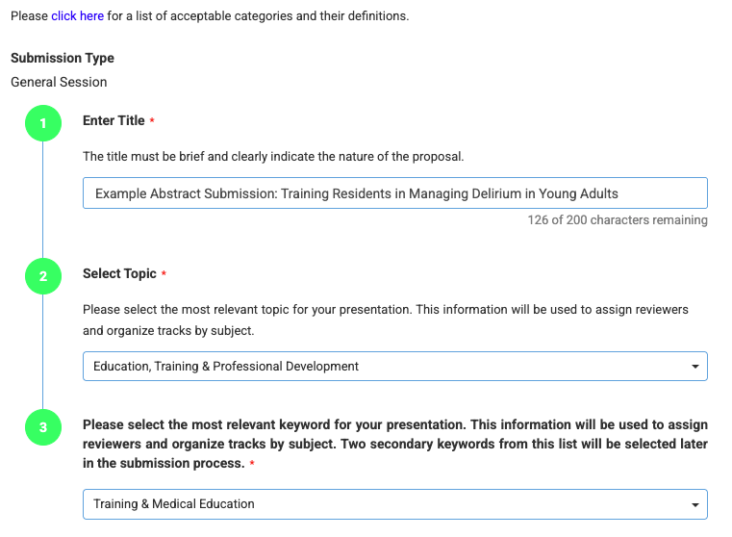
Updated for 2026: Submission Topics and Keywords
Walkthrough: Example session

Slide 33
Updated for 2026: Submission Topics and Keywords
Walkthrough: Example session

Slide 34
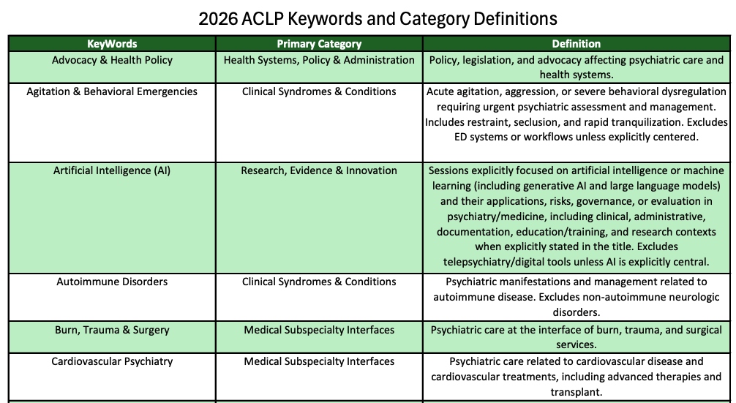
Updated for 2026: Submission Topics and Keywords
Full list online

Slide 35
Updated for 2026: Submission Topics and Keywords
Choose topic from dropdown list

Slide 36
Updated for 2026: Submission Topics and Keywords
Choose primary keyword from dropdown list

Slide 37
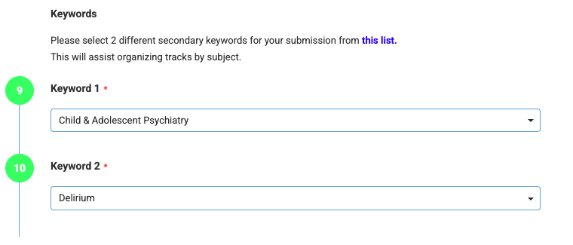
Updated for 2026: Submission Topics and Keywords
Choose two secondary keywords

Slide 38
Updated for 2026: Submission Topics and Keywords
Choose two secondary keywords

Slide 39
Updated for 2026: Submission Topics and Keywords
Things to remember:
Your choice of keywords does not impact scoring of your abstract.
You can choose up to three keywords. You are not required to choose that many.
Keywords help connect your abstract with appropriate reviewers and audience members.
Only use topics and keywords listed on website.
Submitters must select among provided keywords and can not create new keywords.

Slide 40
In Summary
We’ve discussed:
Meeting theme, timeline, and highlights, including abstract pre-review pilot
Advice on the Breadth & Depth Statement
Details on the abstract review process from our three reviewing subcommittees
We look forward to reading your CLP 2026 abstracts and having a fantastic meeting in November!

